Slide 1

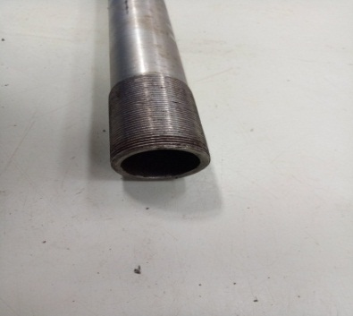
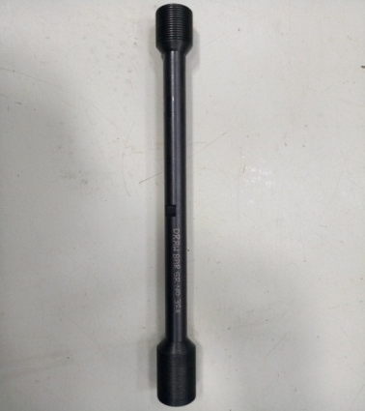
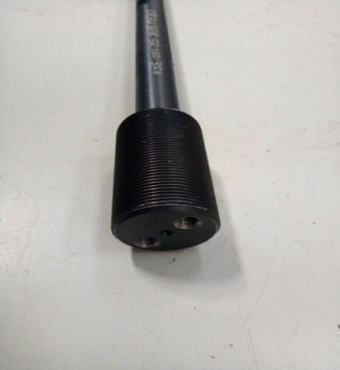
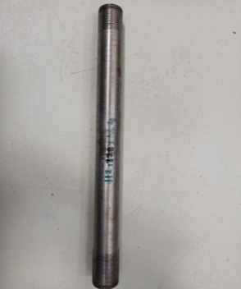
P15
TPM CIRCLE NO :-
ACTIVITY
KK
QM
PM
JH
SHE
OT
DM
E&T
KAIZEN IDEA SHEET
TPM CIRCLE NAME:
LOSS NO. / STEP
DEPT :- Maint.
RESULT AREA
P
Q
A
C
D
S
M
CELL:- Machine Shop
CELL NAME:- Tensioner
MACHINE / STAGE :-
OPERATION :-
KAIZEN THEME:“ To Increase MTBF at tensioner cell”
IDEA :. Hollow Drawbar Design Change & make a Solid Drawbar Design
Problem present status :
COUNTERMEASURE :Used Solid Drawbar Design.
BENCHMARK
3 Month
TARGET
12 Month
KAIZEN START
01.11.2016
KAIZEN FINISH
20.12.2016
TEAM MEMBERS: Sujit
BENEFITS : 1) Increase MTBF
2) Draw bar fount side remove
3) Increase change frequency
Before
After
KAIZEN SUSTENANCE
WHY - WHY ANALYSIS :-
1)Draw bar broken in threading portion
2) Threading portion thickness week
3)Manufacturing Design Defect
RESULT :-
WHAT TO DO:- Increase MTBF
HOW TO DO:- Use solid Drawbar
FREQUENCY :-
ROOT CAUSE : Manufacturing design defect
REGISTRATION NO. & DATE:- 01.11.2016
SCOPE & PLAN FOR HORIZONTAL DEPLOYMENT
REGISTERED BY :- Sujit
SR.
NO.
CELL
TARGET
RESPONSIBILITY
STATUS
MANAGER’S SIGN :-SNC
1

